Slide 1
A Question…

Slide 2

Case Study: How XYZ Co. Leveraged Existing Investment to Transform the WAN
Owen Parsons (BSc. Internet Computing, CCNA-RS, CCDA)
Network & Security Architect
January 17, 2019

Slide 3
Today’s Topic
A case study of the WAN transformation or “FlexVPN Project” for XYZ Co.
XYZ Co. is mining company with operations in the US and EMEA
Project scope covered the global WAN
A foundation level understanding of the material is assumed

Slide 4
Agenda
1
Challenges
2
Solutions
3
Results

Slide 5

Challenges

Slide 6

Business Challenges
Business Challenge
IT Department Challenge
Inconsistent / unreliable application experience
Crew welfare – poor social Internet
24/7 operations & multiple time zones
Global cost reduction targets
→
Lack of visibility & control toolset, inconsistent QoS
Fix without impacting business applications
Keep the network up with no NOC, no on-call & 1.5 engineers
Very small discretionary budget
→
→
→

Slide 7

IT & Technical Challenges
Remit to reduce reliance on MPLS services
QoS policy limitations & complexity due to NNI service
Remit to enhance security
Most sites without qualified remote hands
Requirement for 3rd party interoperability
Site inconsistencies (e.g. ISR 4K, ISR G2, PPPoE, VSAT, bandwidth, MTU)

Slide 8

Solutions

Slide 9
Features, Products and Services

Slide 10
FlexVPN
A single global WAN overlay fabric
  Transport & connection independence
  Dynamic, policy based path selection
  Service chaining support
  A simple control and management toolset
  Strong security through PKI & encryption

Slide 11
FlexVPN
Full Overlay

Slide 12
Complimentary & Integrated Solutions
FlexVPN works with everything
QoS – FlexVPN per-tunnel, egress shaping, ingress policing
DMVPN over FlexVPN for backhauled spoke social Internet access
DIA for spoke Internet access on larger bandwidth sites
Umbrella & ZBFW for web security
Automation of operations – EEM, zero-touch, self-documenting
Toolset – Prime Infrastructure, LiveAction & Opengear

Slide 13

Results

Slide 14
FlexVPN Project
Challenges met
Application experience
  Modular, hierarchical, automated QoS polices and decoupling internal markings from provider
Crew welfare
  Great feedback for both DMVPN and DIA deployments
3rd party interoperability
  IKEv2 and BGP – typically supported on modern, enterprise class edge devices
  Riverbed SteelHead WAN optimization

Slide 15
FlexVPN Project
Challenges met
Security enhancements
  PKI based AAA, Smart Defaults, MPLS encryption, VRF segmentation, ZBFW
Reduced reliance on MPLS services
  Demonstrated reliable, quality, secure communications over Internet
Network uptime & service availability
  Up to 4 failover paths to corporate services per spoke
Site inconsistencies
  FlexVPN is accurate – non-prescriptive deployment, modular & reusable CLI

Slide 16
FlexVPN Project
Challenges met
Resource challenges
  Reusable modular CLI & scripting/automation = faster deployment
  Globally consistent & self-documenting configuration = faster troubleshooting
  Happy users = fewer support calls
Budget challenges
  Using features already available within existing hardware and licensing resulted in insignificant spend
The answer to the original question

Slide 17
Other Solutions
And why I didn’t use them
IWAN
  Too prescriptive, unofficially heading towards legacy
SD-WAN (née Viptela)
  Wasn’t integrated yet, several sites are ISR G2
DMVPN
  FlexVPN is the evolution of DMVPN, with less configuration
A different vendor
  Wouldn’t meet the goal of leveraging existing investment

Slide 18
Questions
?

Slide 19
Thank You

Slide 21

Overtime Slides

Slide 22
Spoke Internet Access
Via Hub when < 10Mbps
DIA when >= 10Mbps
All Internet traffic backhauled to regional hubs
Failover between hubs (upstream failure only)
Umbrella on spoke, ZBFW on hub
QoS via tunnel-in-tunnel, egress shaping & scavenger class
Local breakout of all social and corporate Internet traffic
No failover (single local circuit) ….
Umbrella & ZBFW on spoke …….
QoS via ingress policing & egress shaping

Slide 23
Quality of Service
QoS Challenges
How do I prevent a large bandwidth site from flooding a smaller bandwidth site?
How do I provide good social Internet without affecting business critical applications?
How do I control Internet traffic?
?
?
?

Slide 24
Quality of Service
QoS Solutions – Flood Prevention
FlexVPN hub-to-spoke per-tunnel QoS
Utilised certificate attributes to dynamically apply QoS policies*
CN=wcrgw01.xyzco.local,OU=flex-ap#FlexClient#1.75m#,O=xyzcoUS-W,L=FlexClient,C=US
FlexVPN Mesh per-tunnel QoS
  Tested, but ingress policing proved more suitable
Matches a QoS policy on the hub *exactly*

Slide 25
Quality of Service
QoS Solutions – Social Internet & Internet Control
Via Hub – Egress Only
DIA – Ingress/Egress
Hub
Hub
Egress Shape
Egress Shape
Social Internet Tunnel
“scavenger” class
“not match” on Hub public IP
Egress Shape
Egress Shape
Ingress Police
Spoke
Spoke

Slide 26
Social Internet DMVPN
Anycast Redundancy
iBGP (global routing table)
  Hubs send 0.0.0.0/0
  Spoke sends 10.x.0.0/16
  Metric = Local Preference
Hubs have Lo23 Anycast IP
Spoke connects to mGRE Tu25323 via preferred Lo23 IP
EIGRP (social VRF)
  Hub sends 0.0.0.0/0
  Spoke sends 10.x.23.0/24
Lo23
10.80.253.23
Lo23
Hub 1
Hub 2
Local Pref 300
Local Pref 200
Spoke

Slide 27
Social Internet DMVPN
Anycast Redundancy - Failover
Lo23
10.80.253.23
Lo23
FlexVPN tunnel to Hub 1 is lost
DMVPN tunnel to Hub 1 drops
Spoke has a route to Lo23 IP via FlexVPN tunnel to Hub 2
Spoke establishes DMVPN tunnel to Hub 2
EIGRP (social VRF) establishes and service is restored
Hub 1
Hub 2
Local Pref 300
Local Pref 200
Spoke

Slide 28
Solutions for Reducing Overhead
Minimal Touch Configuration
Modular & reusable CLI constructs
  Easy templating in Prime Infrastructure
Automation of operations
  Routing protocols, dynamic BGP peers, Virtual Templates, mGRE, IP pools, EEM, FlexVPN AAA based configuration etc.
Near zero-touch on hubs for FlexVPN
  dVTI = zero touch
  sVTI = one push from PI and one from LiveNX

Slide 29
Solutions for Reducing Overhead
Interface & Path Information
GRE supports CDP
  sVTI – CDP triggers EEM script event to update interface description
  dVTI – Can’t update description of VA interface, check CDP table directly
Tunnel interface IPs in DNS
  Standard provider practice, significantly enhances traceroute
  Simplified with PowerShell

Slide 30
Social Internet DMVPN
How did it help?
Application experience
  Full circuit bandwidth available to business applications on demand
Crew welfare
  Full circuit bandwidth available to social Internet when not required by business applications
Resource challenges
  Zero-touch deployment hub-side and almost identical spoke configuration
    ‘ip address dhcp’ option missing/removed on spoke ISR4k tunnel configuration

Slide 31
Direct Internet Access
How did it help?
Application experience
  Increasing bandwidth available for corporate applications resulted in great feedback
Resource challenges
  Happy users = fewer support calls
  Zero-touch deployment on hubs
Budget challenges
  Maximised ROI on all spoke Internet services and reduced load on the hub Internet

Slide 32
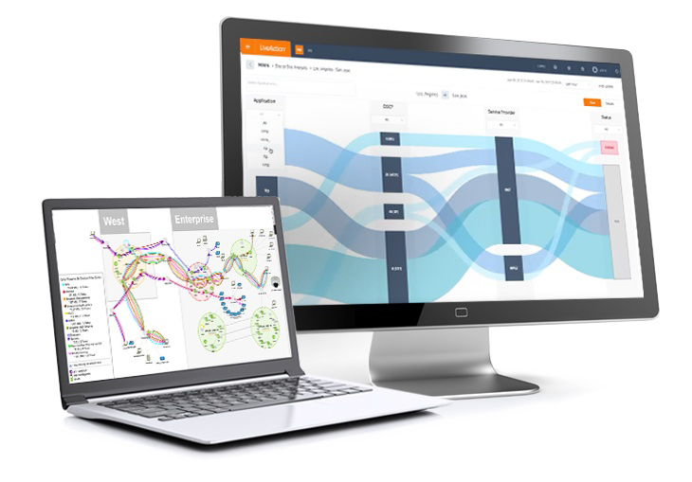
LiveAction LiveNX
How did it help?
QoS toolset & consistency
  Central QoS management = global consistency
  Second-to-none visibility of the entire WAN+
Resource challenges
  Able to rapidly pin-point issues (proactively)
  Effort of MACs dramatically reduced
  Very easy setup, very intuitive interface

Slide 33
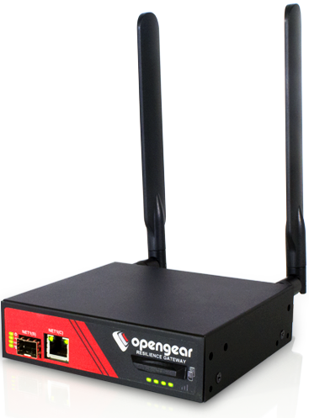
Opengear Out-Of-Band
How did it help?
Remote hands
  After easy deployment significantly reduces reliance on remote hands
  Remote hands only need basic knowledge
Resource challenges
  Reduced cross-time zone resource scheduling
  True OOB - takes the fear out of remote changes
NOTE: Where this wasn’t an option EEM saved the day

